Slide 1
10. REVISON GRAPH

Slide 2
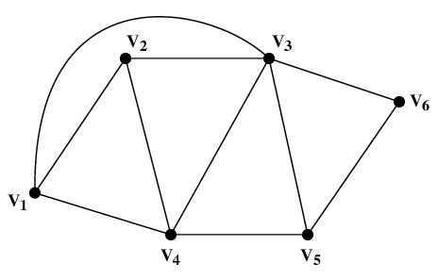
10.1 Terminology
What is a Graph?
Informally, a graph is a finite set of dots called nodes (or vertices) connected by links called edges (or arcs).
It is a pair G = (V, E), where
  V = V(G) = set of vertices
  E = E(G) = set of edges
Example:
  V = {V₁, V₂, V₃, V₄, V₅, V₆}
  E = {(V₁,V₂), (V₁,V₃), (V₁,V₄), (V₂,V₃), (V₂,V₄), (V₃,V₄), (V₃,V₅), (V₃,V₆), (V₄,V₅), (V₅,V₆)}
Dr. Cristina Muntean (NCI)
Notes:
The Graph ADT
06/04/2004
NCI Y2 SWD 4

Slide 3
10.1 Terminology
Edges (or arcs)
An edge may be labeled by a pair of vertices, for instance e = (v₃,v₄).
e is said to be incident on v₃ and v₄.
Parallel edges
  Two or more edges joining a pair of vertices
  in the example, v₁ and v₄ are joined by two parallel edges
Loops
  An edge that starts and ends at the same vertex
  In the example, vertex v₅ has a loop
e
Dr. Cristina Muntean (NCI)

Slide 4
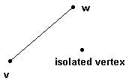
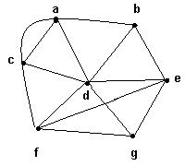
10.1 Terminology
Vertices (or nodes)
Two vertices are said to be adjacent if they are endpoints of the same edge.
Isolated vertex is a vertex without incident edges.
The degree of a vertex v, denoted by δ(v), is the number of edges incident on v
Example:
  δ(a) = 4, δ(b) = 3,
  δ(c) = 4, δ(d) = 6,
  δ(e) = 4, δ(f) = 4,
  δ(g) = 3.
Dr. Cristina Muntean (NCI)

Slide 5
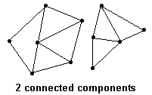
10.1 Terminology
Connected Graphs
A graph is connected if every pair of vertices (nodes) can be connected by a path
An empty graph on n nodes consists of n isolated nodes with no edges.
Dr. Cristina Muntean (NCI)

Slide 6

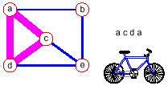
10.1 Terminology
Path and Cycle
A path of length n is a sequence of n + 1 vertices (nodes) and n consecutive edges (no vertex is repeated)
A cycle is a path that begins and ends at the same vertex
Dr. Cristina Muntean (NCI)
Notes:
The Graph ADT
06/04/2004
NCI Y2 SWD 4
A trail is a walk in which no edge is repeated.
A walk is a sequence of edges in which the end of one edge (except for last) is beginning of the next.

Slide 7
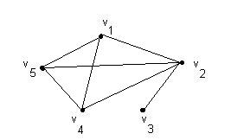
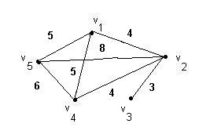
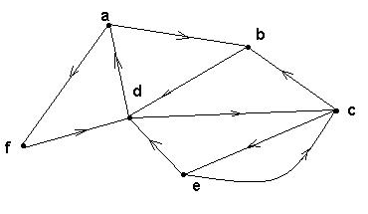
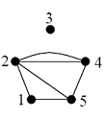
10.1 Terminology
Special Graphs
Simple graph
  A graph without loops or parallel edges.
Weighted graph
  A graph where each edge is assigned a numerical label or “weight”.
Directed graphs (digraphs)
  G is a directed graph if each edge has been associated with an ordered pair of vertices, i.e. each edge has a direction
Multi- graph
  more then one edge exists between two nodes
Combination of these types:
  Weighted directed graph
  Directed (weighted) multi-graph
Dr. Cristina Muntean (NCI)

Slide 8
10.2 Directed Graphs
A directed graph is a graph whose edges are all directed.
A graph that has both directed and undirected edges is often called a mixed graph.
The first endpoint of a directed edge is it’s origin and the other is the destination.
The outgoing edges of a vertex are the directed edges whose origin is that vertex. (inDegree)
  E.g. for node a: (a, b) and (a, f)
The incoming edges of a vertex are the directed edges whose destination is that vertex. (outDegree)
  E.g. for node a: (d, a)
Dr. Cristina Muntean (NCI)

Slide 9
10.3 Application of Graphs
Graphs have applications in a host of different domains, including:
  Mapping ( geographic information systems ).
  Transportation ( in road and flight networks ).
  Electrical Engineering (in circuits).
  Computer networking (In the connections of the Internet).
    Switches & routers are vertices
    Communication lines are edges
    Routing protocols use shortest path algorithms
Because applications for graphs are so widespread and diverse, people have developed a great deal of terminology to describe different components and properties of graphs.
Dr. Cristina Muntean (NCI)

Slide 10
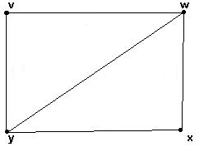
10.4 Graphs Representation (Adjacency Matrix)
Undirected Graphs
 | v | w | x | y
v | 0 | 1 | 0 | 1
w | 1 | 0 | 1 | 1
x | 0 | 1 | 0 | 1
y | 1 | 1 | 1 | 1
Rows and columns are labeled with ordered vertices
Fill in the table by writing:
  1 if there is one edge between the row vertex and the column vertex
  0 if no edge exists between them
Dr. Cristina Muntean (NCI)

Slide 11
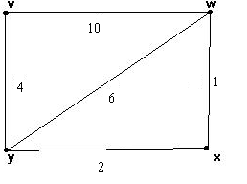
10.4 Graphs Representation (Adjacency Matrix)
Weighted Graphs
 | v | w | x | y
v | 0 | 10 | 0 | 4
w | 10 | 0 | 1 | 6
x | 0 | 1 | 0 | 2
y | 4 | 6 | 2 | 0
Rows and columns are labeled with ordered vertices
Fill in the table by writing:
  The “weight” value, if there is an edge between the row vertex and the column vertex
  0 if no edge exists between them
Dr. Cristina Muntean (NCI)

Slide 12
10.4 Graphs Representation (Adjacency Matrix)
Directed Graphs
 | a | b | c | d | e | f
a | 0 | 1 | 0 | 0 | 0 | 1
b | 0 | 0 | 0 | 1 | 0 | 0
c | 0 | 1 | 0 | 0 | 1 | 0
d | 1 | 0 | 1 | 0 | 0 | 0
e | 0 | 0 | 1 | 1 | 0 | 0
f | 0 | 0 | 0 | 1 | 0 | 0
Rows and columns are labeled with ordered vertices
Fill in the table by writing:
  1 if there is one outgoing edge between the row vertex and the column vertex
  0 if no edge exists between them
Dr. Cristina Muntean (NCI)

Slide 13
10.4 Graphs Representation (Adjacency Matrix)
Multi Graphs
 | 1 | 2 | 3 | 4 | 5
1 | 0 | 1 | 0 | 0 | 1
2 | 1 | 0 | 0 | 2 | 1
3 | 0 | 0 | 0 | 0 | 0
4 | 0 | 2 | 0 | 0 | 1
5 | 1 | 1 | 0 | 1 | 0
Rows and columns are labeled with ordered vertices
Fill in the table by writing:
  1 if there is one edge between the row vertex and the column vertex
  OR
  n if there are n edges between the row vertex and the column vertex
  0 if no edge exists between them
Dr. Cristina Muntean (NCI)

Slide 14
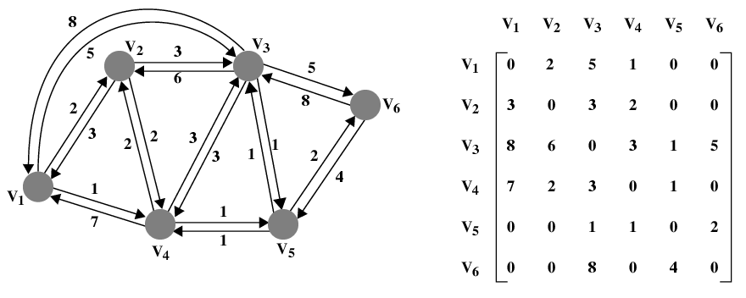
10.4 Graphs Representation (Adjacency Matrix)
Weighted and Directed Graphs
Dr. Cristina Muntean (NCI)

Slide 15
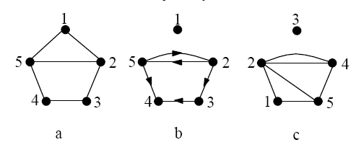
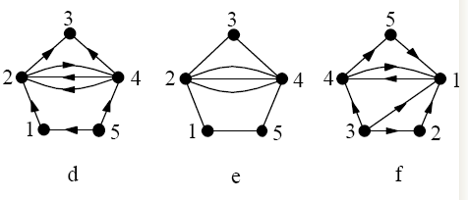
10.4 Graphs Representation (Adjacency Matrix)
Tasks
1. Which graphs are directed, undirected, weighted or multi-graphs ?
Dr. Cristina Muntean (NCI)

Slide 16
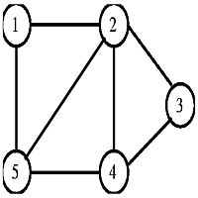
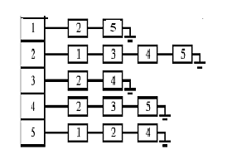
10.6 Data Structures for Graphs
Two main data structures for the representation of graphs are used in practice
  adjacency list
  adjacency matrix
Adjacency list
  Each node represented as a data structure that contains a list of all adjacent nodes.
  N x 1 array of pointers, where the i th element points to a linked list of the edges incident on vertex i.
Dr. Cristina Muntean (NCI)

Slide 17
10.6 Data Structures for Graphs
Adjacency matrix
  the rows and columns of a two-dimensional array (matrix) represent source and destination vertices and entries in the graph indicate whether an edge exists between the vertices
  N x N matrix, where M[i,j] = 0 iff there is no edge from vertex i to vertex j
 | 1 | 2 | 3 | 4 | 5
1 | 0 | 1 | 0 | 0 | 1
2 | 1 | 0 | 1 | 1 | 1
3 | 0 | 1 | 0 | 1 | 0
4 | 0 | 1 | 1 | 0 | 1
5 | 1 | 1 | 0 | 1 | 0
Dr. Cristina Muntean (NCI)

